Slide 1

VULNERABILITY ANALYSIS & COUNTERMEASURES
Hardware Trojan Detection in AES-128 Crypto Systems
A Full-Flow EDA Framework for Power-Based Security Verification
Venkata Shanmukha Sri Sudha Renduchintala

Slide 2

1. Motivation & Project Scope
Modern electronic systems are vulnerable to **Hardware Trojans (HT)**—malicious circuit modifications that can remain dormant for years. My research focuses on the "Stealthy analog trigger" paradigm.
Key Research Question
"Can the minute power signature of an activated analog Trojan be reliably distinguished from normal circuit noise and noise variations?"
•
Detection Challenge: Analog Trojans target physical parameters (voltage, power) instead of logic, making standard functional testing obsolete.
Goal: Build a non-invasive side-channel detection framework.
•
Target: The AES-128 cryptographic algorithm, a high-value target for key exfiltration.
•
Methodology: Establishing a quantifiable **Power Consumption Threshold** using industry-standard Synopsys tools.

Slide 3





2. Theoretical Foundation: Taxonomy
To design a detection framework, we must first understand the diverse triggers and actions used by adversaries.
Trigger Mechanisms
Payload Actions
Analog Stealth (A2)
Internal: Activated by node values (Combinational) or sequence of events (Sequential). Analog: Reacts to physical conditions like voltage or charge.
Logic: Modifies functionality or specifications. Exfiltration: Leaks sensitive data (Keys) via power, timing, or RF signals.
Uses capacitor charge accumulation from infrequent transitions. Extremely hard to detect as it draws near-zero current during dormancy.

Slide 4




3. Implementation: Combinational Trojan
The first design phase involved integrating a combinational Trojan into an open-source AES-128 core. The goal was to corrupt the cipher in a predictable way for key recovery.
Vulnerability Analysis
When activated, the AES algorithm produces a **corrupted ciphertext**. While the system appears "broken" to the user, the attacker uses this corrupted output to perform a **Secret Data Retrieval** attack.
Activation: Triggered by a specific 128-bit "Golden Plaintext" input.
Key Manipulation: During the **10th Round**, the round key is OR'ed with a trigger register.
•
High stealth: No impact on other plaintexts.
•
Precision: Targets only the final round of the encryption pipeline.

Slide 5


4. Implementation: The Exploit Chain
I demonstrated that simply corrupting the output allows for a full reconstruction of the master secret key via two distinct steps:
Step 1: Round-10 Key Extraction
Step 2: Key Expansion Reversal
The corrupted ciphertext is XORed with a known value (0x1616...) to isolate the final round key.
I developed a Python script to reverse the AES Key Schedule. Starting from the extracted Round-10 key, it backtracks to recover the original master key.
•
Automated the XOR operations.
•
Verified against Trusted Round Key tables.
Success: 100% Master Key Recovery achieved from a single malicious activation cycle.

Slide 6


5. Implementation: Advanced Sequential Logic
To increase stealth, a sequential Trojan was implemented. This requires the target plaintext to be seen three times consecutively.
Design Lessons Learned
•
Pipeline Lag: Latency in the round key distribution affects trigger synchronization.
•
Reset Failure: The circuit failed to properly disengage after activation, causing persistent corruption.
Observed Anomaly & Debugging
During simulation, the Trojan activated on the 4th arrival instead of the 3rd. Analysis revealed a timing synchronization issue between the counter register and the AES pipeline stages.
•
Validation: Highlighted the critical need for post-synthesis timing verification.

Slide 7
6. Analysis Flow: Industry Standard Tooling
The project strictly followed the standard digital VLSI design flow using the Synopsys tool suite.
Process Stage | Synopsys Tool | Technical Activity
Logic Synthesis | Design Compiler (DC) | TCL scripts used to map RTL to gate-level netlists with .sdc constraints.
Simulation | VCS & SimVision | Functional verification of Trojan-free vs. Trojan-inserted designs; VCD generation.
Power (Averaged) | PrimePower | Calculation of dynamic, internal, and leakage power over full execution.
Power (Time-Based) | PrimeTime (PX) | High-resolution waveform analysis to detect localized power spikes.

Slide 8

7. Detection Metrics: PrimePower Results
Averaged dynamic power analysis identifies the constant logic overhead introduced by the malicious modifications.
Trojan-Free AES
Trojan-Activated AES
Change in Average Dynamic Power
Analysis
28.94 µW
This 28.94 µW difference is the "Static Signature" of the Trojan. While small, it represents a quantifiable shift in the circuit's steady-state behavior, establishing our first detection baseline.
Detectable overhead of active Trojan logic.

Slide 9


8. Detection Metrics: PrimeTime (PX) Results
Time-based analysis provides granular visibility. While average power shows overhead, PrimeTime captures the "Moment of Activation."
Waveform Observation
Simulation of Value Change Dump (VCD) files revealed that the Trojan-inserted design remains indistinguishable from the Golden design except at the cycle where the malicious trigger condition is met.
Peak Power Delta
0.1267 W (Active) 0.1266 W (Free)
Power analysis is more effective than functional testing for detecting covert Trojans.
Signature: 100 µW Spike

Slide 10
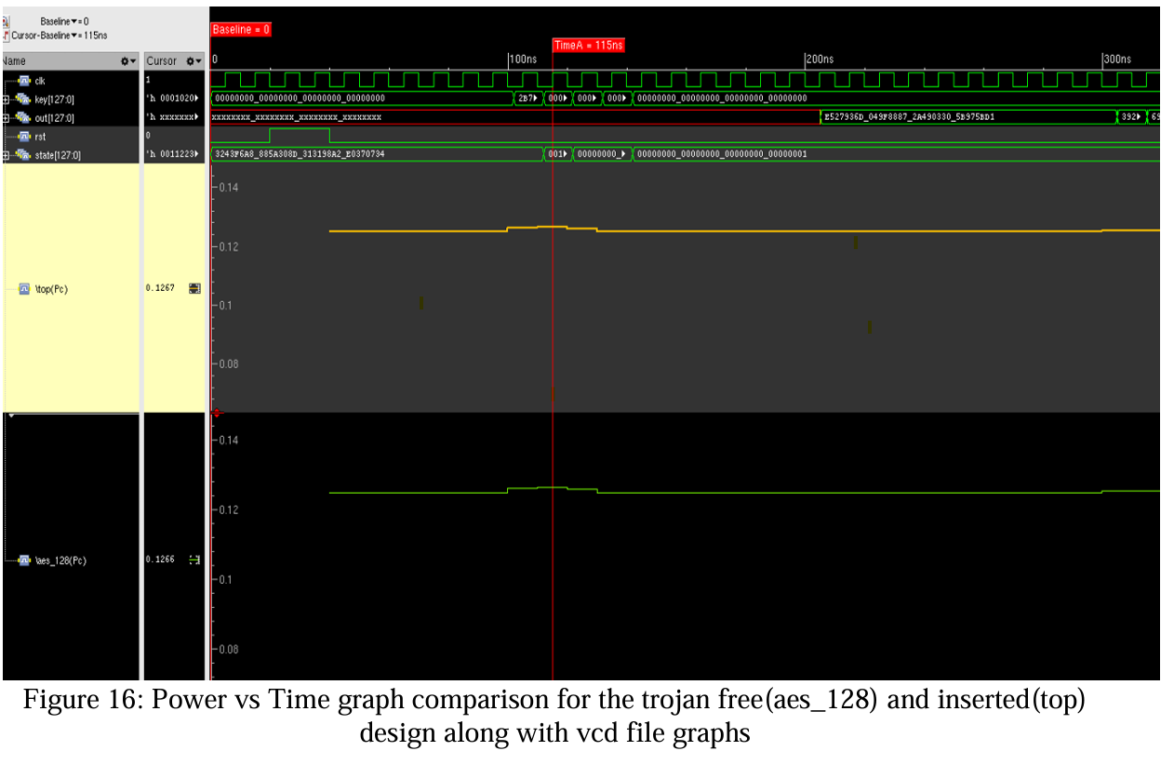
8. Detection Metrics: PrimeTime (PX) Results

Slide 11


9. Conclusions & Strategic Takeaways
Technical Summary
Detection Reliability
Crypto Integrity
Successfully demonstrated the full lifecycle: Trojan implementation ->Synthesis
->Simulation
->Side-channel detection.
Identified a reliable detection threshold of 100 mW peak power signature, validating non-invasive detection methods.
Proved that localized round-key corruption allows for 100% master key retrieval through schedule backtracking.
"This research establishes a practical framework for identifying compromised circuits in high-security environments where hardware trust is paramount."

